Slide 1



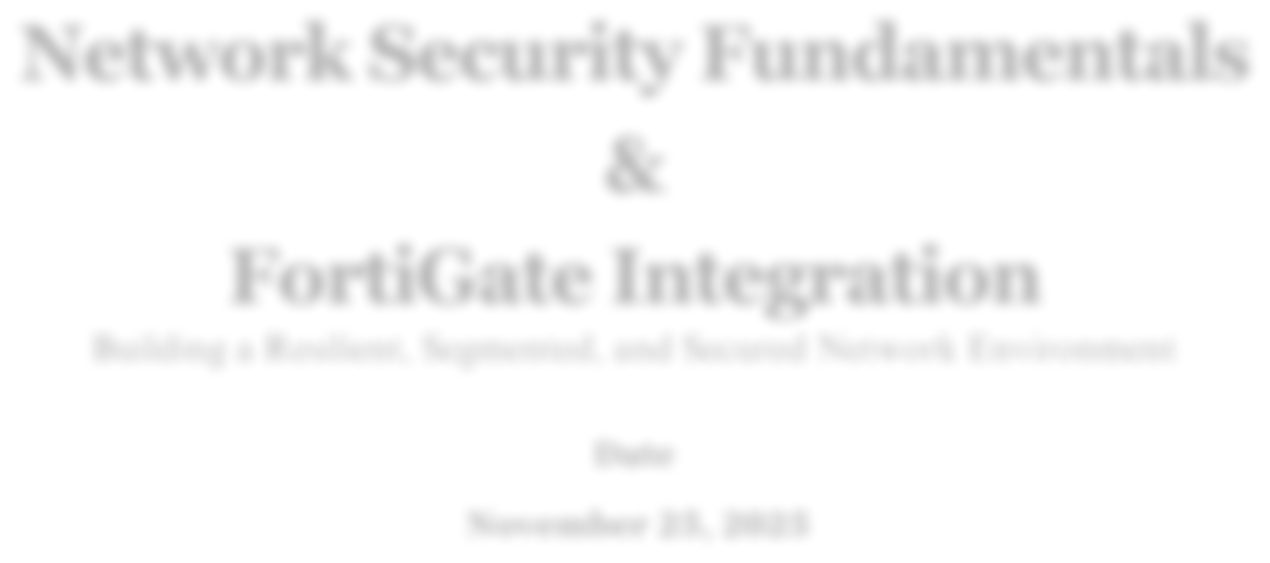
Network Security Fundamentals & FortiGate Integration
Building a Resilient, Segmented, and Secured Network Environment
Date November 25, 2025
PAGE 1

Slide 2









Prepared By :
Mostafa Hossam eldein Ebrahem
Sara Hatem Mohamed
Rawda Ayman Saad Rashed
Omar Adil Selim
Shaza Muhmad Sofy Abdelwahed
PAGE 2

Slide 3

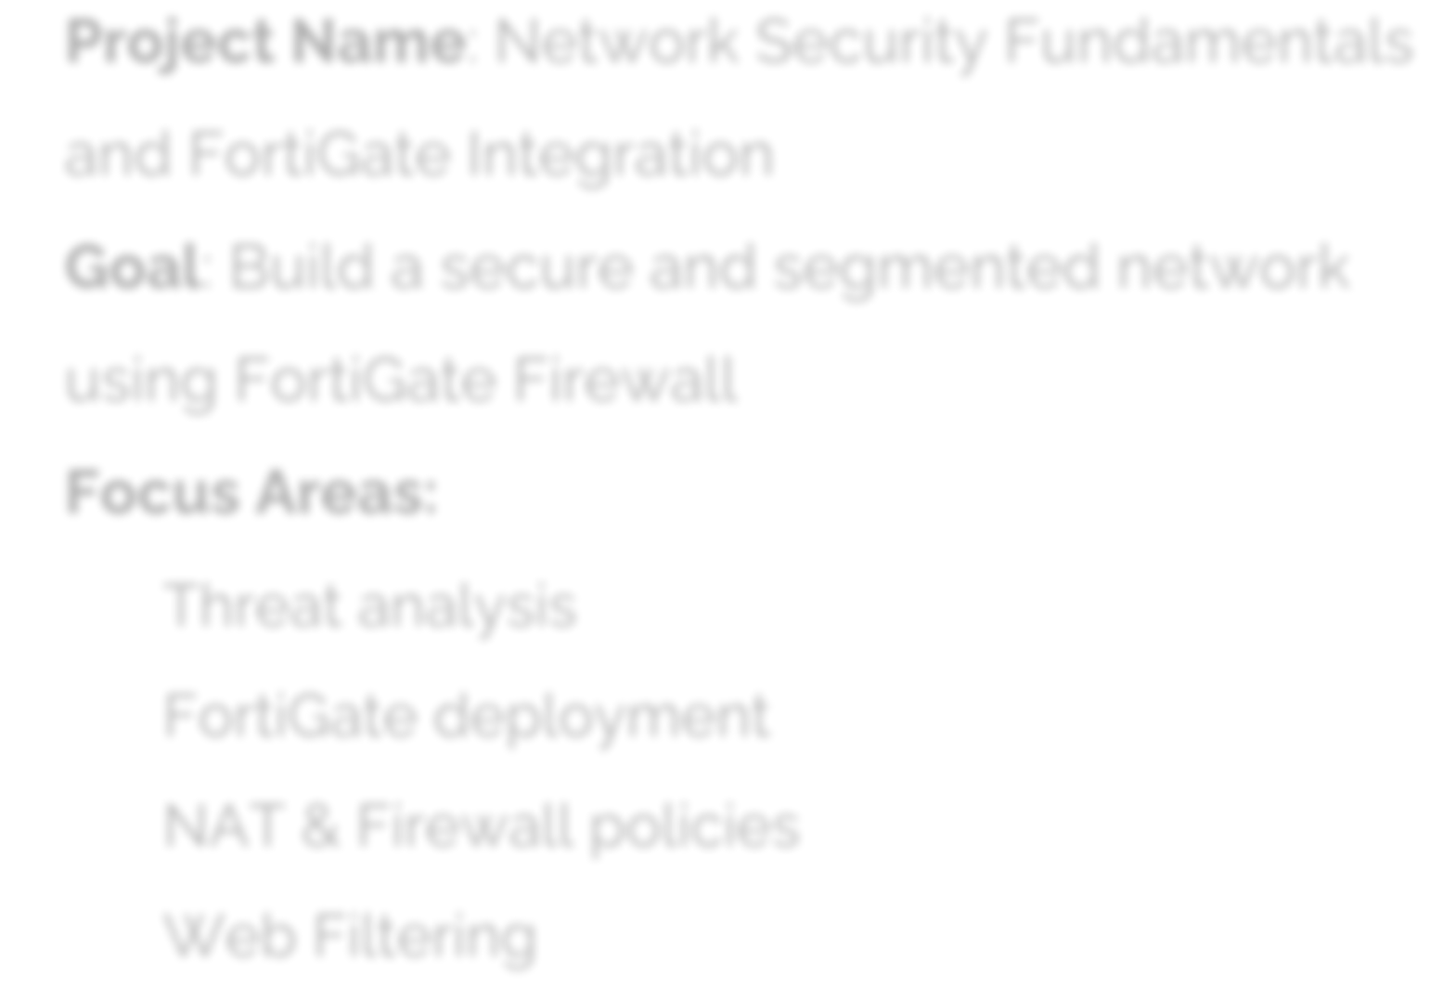


Project Overview
Project Name: Network Security Fundamentals and FortiGate Integration Goal: Build a secure and segmented network using FortiGate Firewall Focus Areas:
Threat analysis FortiGate deployment NAT & Firewall policies
PAGE 3

Slide 4







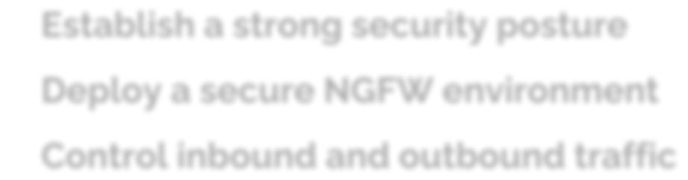





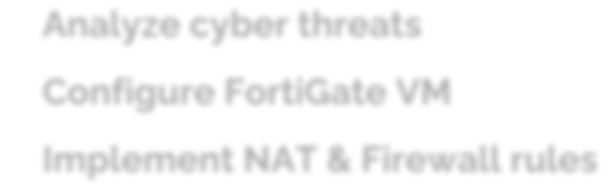
Project Goals & Objectives
1.
GOALS:
Establish a strong security posture Deploy a secure NGFW environment Control inbound and outbound traffic
2.
OBJECTIVES:
Analyze cyber threats Configure FortiGate VM Implement NAT & Firewall rules
PAGE 4

Slide 5


WEEK 1 Network Security Fundamentals
Major Threats
Phishing & Social Engineering
Malware (Ransomware, Viruses, Worms)
DoS/DDoS Attacks
Man-in-the-Middle (MitM)
Insider Threats
Key Vulnerabilities
Weak / Reused Passwords
Unpatched Systems
Misconfigurations
PAGE 5

Slide 6


CIA Triad
→ Confidentiality Encryption + Strong/MFA/Biometric Auth
→ Integrity Hashing + Backups + Permissions
→ Availability Redundancy + Disaster Recovery
PAGE 6

Slide 7


Countermeasures & WannaCry Lesson
Essential Protections
User Training
Regular Patching + Antivirus
HTTPS + VPN (vs MitM)
DDoS Protection
Least Privilege + Monitoring
WannaCry 2017
→ Exploited unpatched Windows (EternalBlue)
Key Lesson: Patch fast + Layered defense + Awareness
PAGE 7

Slide 8

WEEK 2 FortiGate Deployment & Initial Configuration
Nework Topology used
FortiGate dashboard overview
Static & Dynamic interfaces
Routing Table Review
Initial firewall policies before applying
any advance filtering
PAGE 8

Slide 9

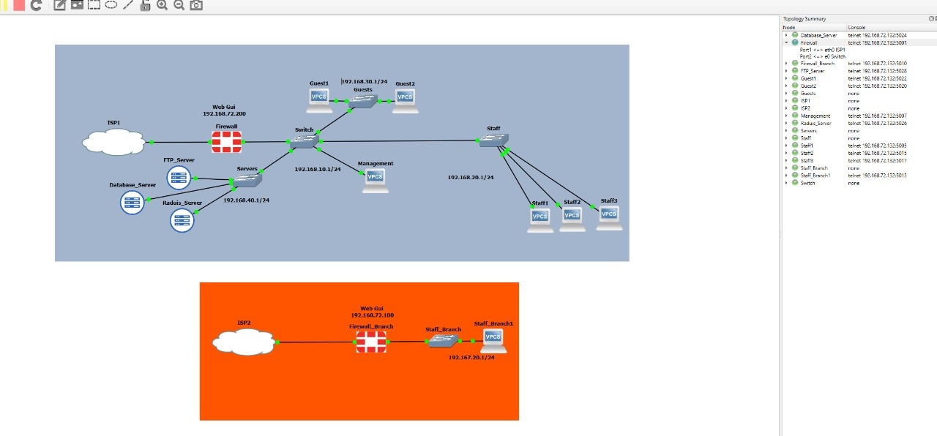
Network Topology
Shows the overall network design used in the FortiGate setup
( WAN, LAN segments, internal interfaces, and how devices are interconnected. It visualizes the logical flow of traffic through the firewall.)
PAGE 9

Slide 10

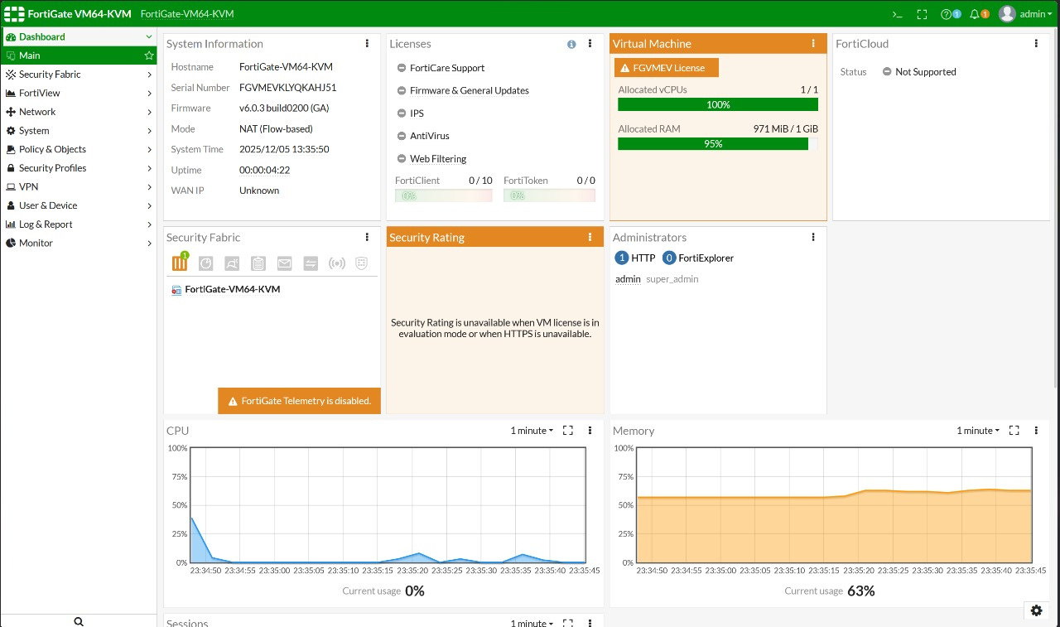
FortiGate Dashboard Overview
Shows system status
Displays resource usage
(CPU, RAM, sessions)
Shows interface connectivity status
Provides real-time traffic visibility
Alerts and security logs
PAGE 10

Slide 11

Static Network Interfaces
Configured internal LAN interfaces manually
Assigned IP addresses required for internal network communication
Set administrative access (HTTP/HTTPS/SSH) for management
Ensured links were active so the firewall could communicate with internal devices
This step created the foundation for routing and future policies
PAGE 11

Slide 12
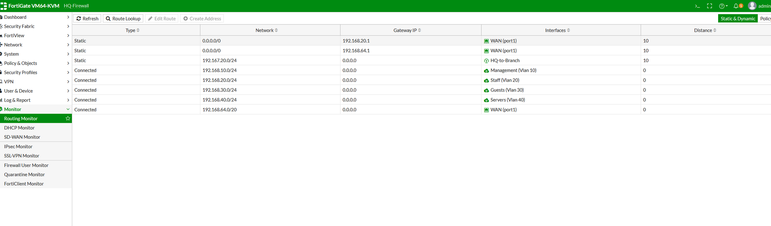
Static Network Interfaces
PAGE 12

Slide 13
Dynamic Network Interface
Configured the WAN port to obtain its IP automatically (DHCP)
Verified the public IP assigned by the ISP/router
Ensured internet connectivity was working
This interface is what allows the firewall to reach the outside world
Critical step before creating NAT or security policies
PAGE 13

Slide 14
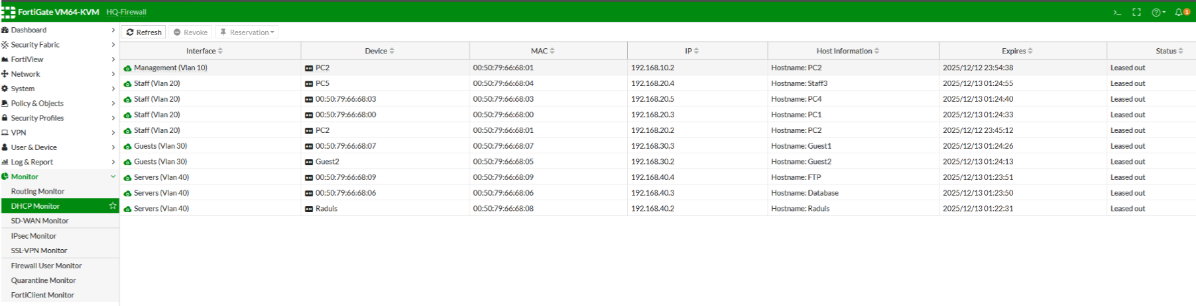
Dynamic Network Interface
PAGE 14

Slide 15
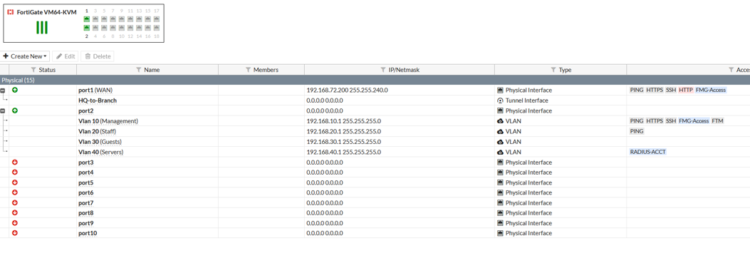
Routing Table Review
Verified the routing table: default route to WAN + LAN routes correctly listed.
Ensured no missing or conflicting routes, confirming proper traffic flow to LAN and internet
PAGE 15

Slide 16
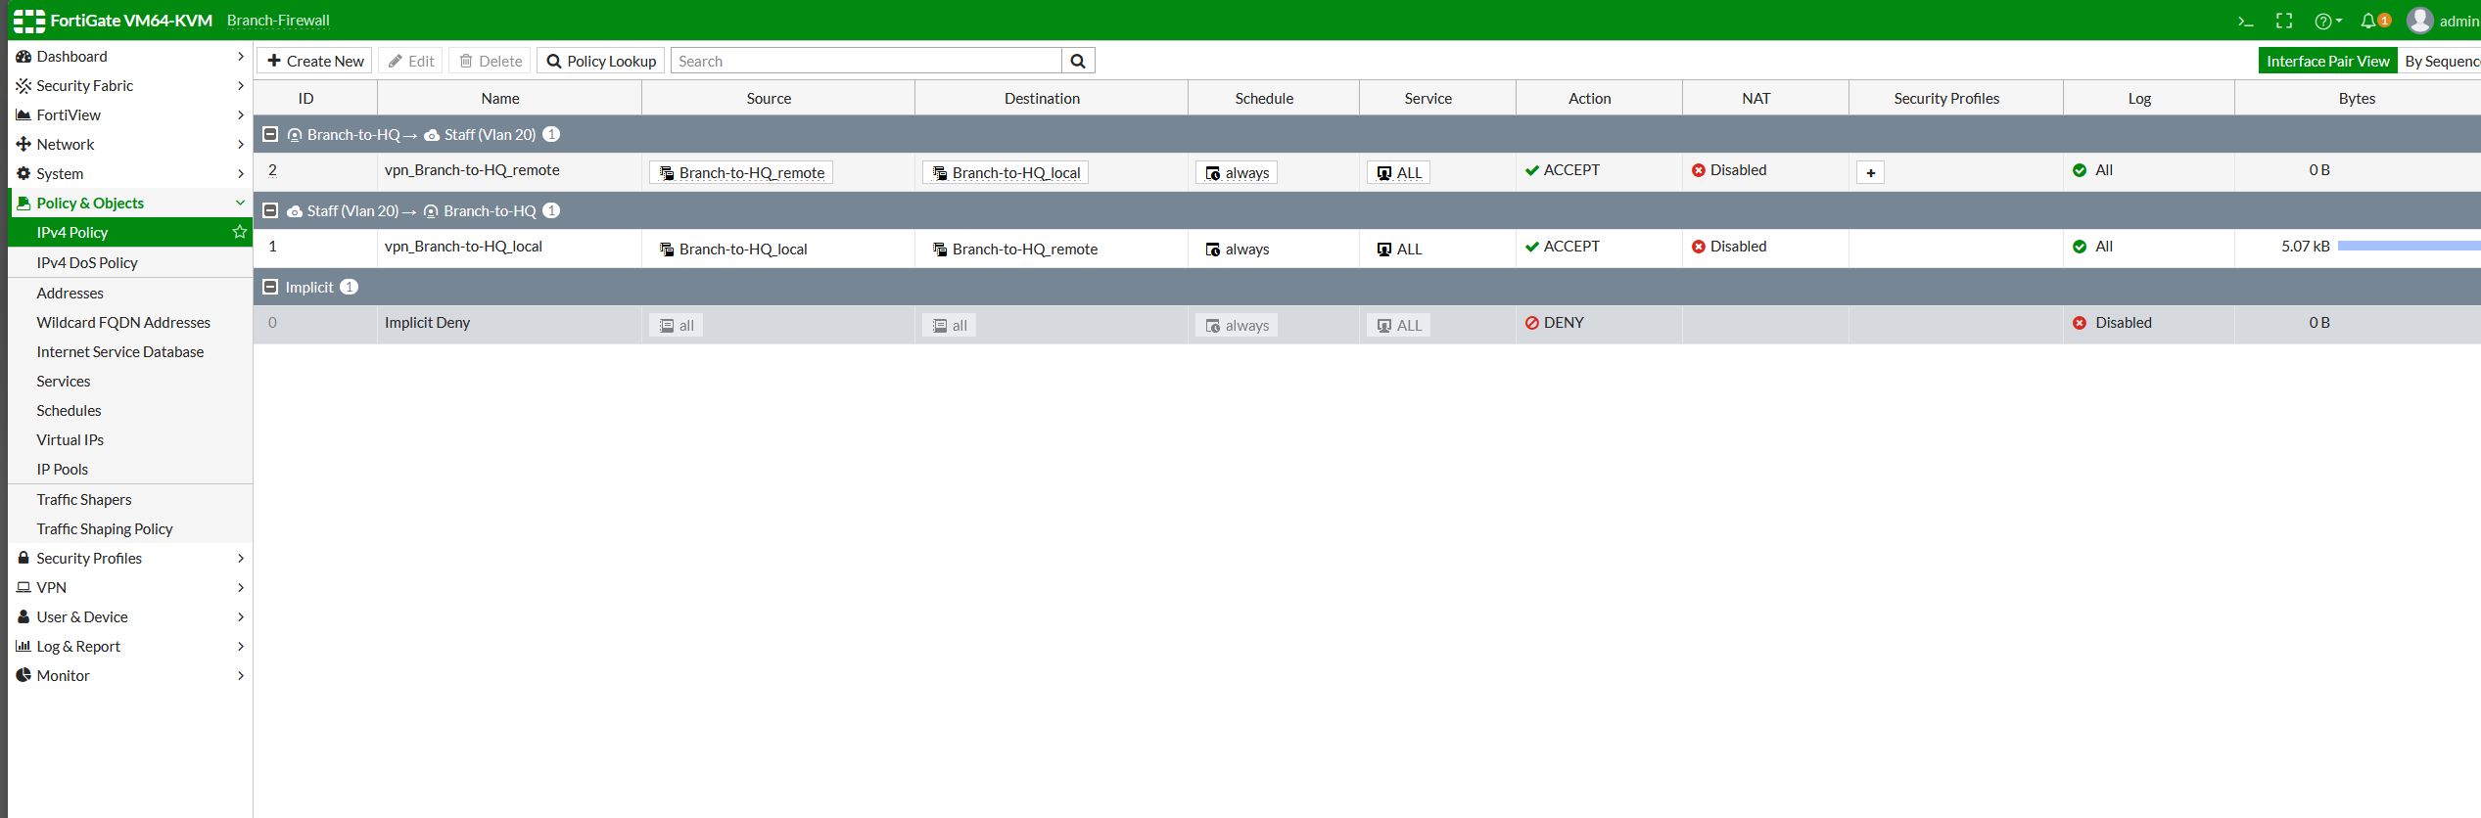
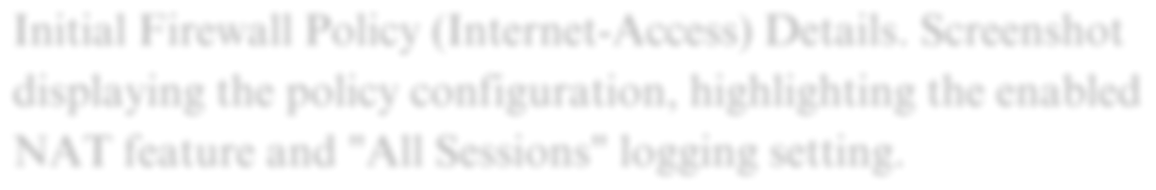
Initial Firewall Policy
Confirmed which traffic is allowed (between Branch and HQ)
Reviewed the source and destination interfaces used by the VPN tunnel.
Checked the rule order and implicit deny to understand the full traffic flow.
PAGE 16

Slide 17

Week 2 Summary
Built the initial FortiGate setup and verified system readiness
Configured static LAN and dynamic WAN interfaces
Validated internal/external connectivity through routing checks
Reviewed initial firewall policies and default traffic flow
Ensured the network is structured and prepared for next security phases
PAGE 17

Slide 18

WEEK 3
Advanced Policies & NAT Implementation
Configured firewall policies for VLANs and VPN.
Enabled secure internet access for Staff and Guests.
Implemented HQ ↔ Branch site‑to‑site VPN.
Validated NAT, routing, and DHCP functionality.
PAGE 18

Slide 19
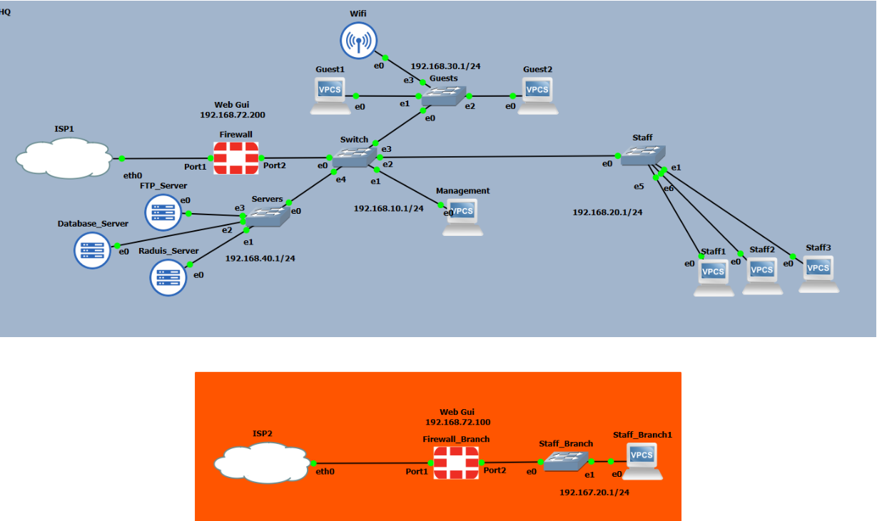
Network Topology Overview
Shows HQ VLANs, Branch link, and WAN connection.
Highlights the path of internal and VPN traffic.
PAGE 19

Slide 20
Policy ID 3 – Staff Internet
Allows VLAN 20 to access internet through WAN.
NAT enabled; security profiles applied.
Covers HTTP/HTTPS/DNS
PAGE 20

Slide 21
Policy ID 4 – Branch-to-HQ Local Traffic
Allows return traffic from Branch to HQ via VPN.
NAT disabled to preserve internal addressing.
“Required for full two‑way VPN connectivity”
PAGE 21

Slide 22
Policy ID 5 – HQ-to-Branch Communication
Staff VLAN can access Branch through VPN tunnel.
All services allowed; security inspection enabled.
Core rule for site‑to‑site connectivity.
PAGE 22

Slide 23
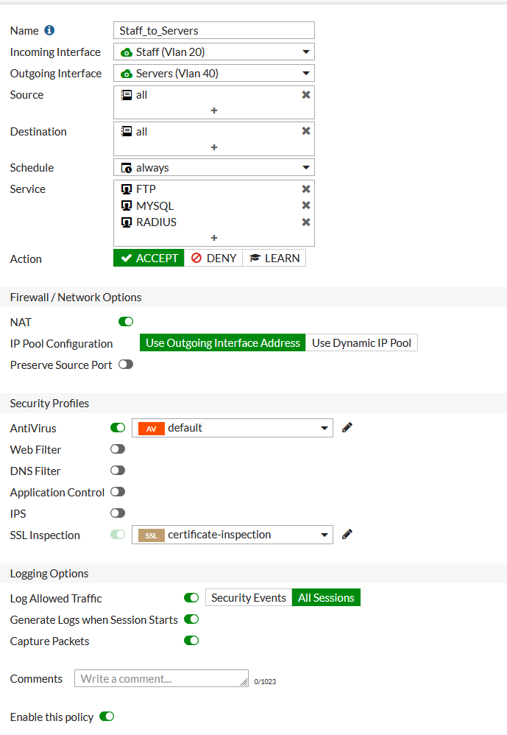
Policy ID 6 – Staff Access to Servers
VLAN 20 allowed to reach VLAN 40 for restricted services.
FTP, MySQL, RADIUS enabled.
Security and NAT applied.
PAGE 23

Slide 24
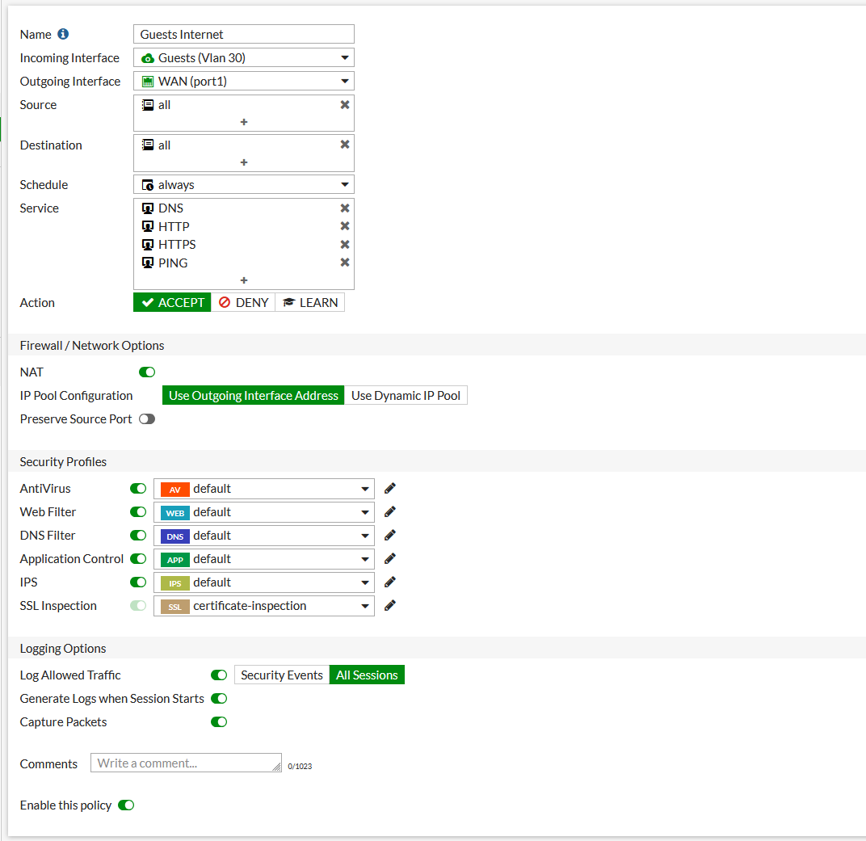
Policy ID 7 – Guests Internet Access
Guests (VLAN 30) allowed limited internet access.
Only DNS, HTTP, HTTPS, PING allowed.
Strict inspection applied.
PAGE 24

Slide 25
Session Table & VPN Verification
Shows active sessions across VLANs (Staff, Guests, Servers).
ICMP entries confirm successful inter-VLAN connectivity.
DHCP broadcasts show devices receiving IPs normally.
SNAT is active → internal IPs are translated to the firewall’s WAN IP when going to the internet.
DNAT is active → firewall handles traffic coming from outside into internal networks.
UDP/500 session indicates an active IPsec VPN negotiation.
PAGE 25

Slide 26
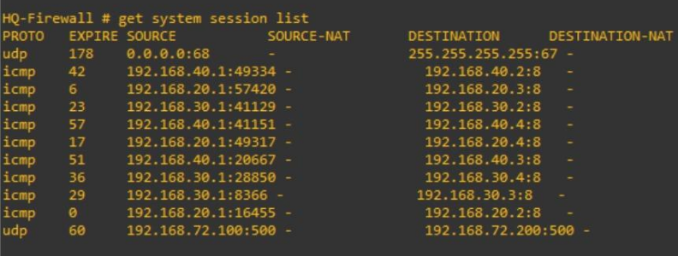
Session Table & VPN Verification
PAGE 26

Slide 27
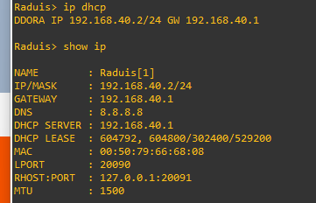
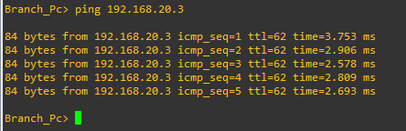
DHCP Validation – Guest Network
First DHCP attempt failed (interface initializing).
Second attempt completed DORA cycle.
Guest2 received valid IP and gateway.
PAGE 27

Slide 28
Week 3 Summary
All VLANs were configured and linked through secure, well-defined firewall policies.
Internet access for Staff and Guests works with proper filtering and NAT.
Site-to-site VPN between HQ and Branch is fully functional and verified.
Internal services are protected through controlled access rules.
DHCP, NAT, routing, and session handling were successfully validated.
“The network is stable, secure, and operating exactly as designed”
PAGE 28

Slide 29
Week 4
Presentation & Final Report
Compiled all project findings from Week 1 to Week 3
Structured a professional presentation summarizing:
Threat analysis FortiGate configuration Policies & NAT Testing
Organized configuration steps, policies, NAT rules, and screenshots
Ensured all tasks meet the project requirements and learning objectives
PAGE 29

Slide 30
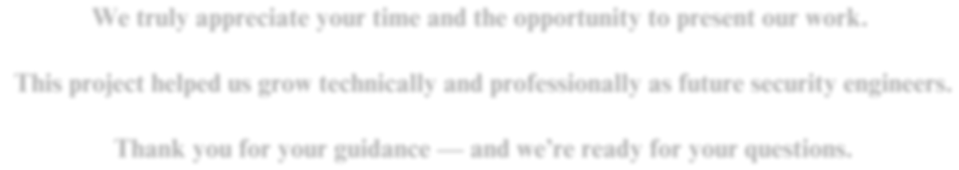
Thank You
We sincerely appreciate your time and the opportunity to present our work.
This project has been a valuable experience for us to grow technically and professionally as future security engineers.
Thank you for your guidance and support
PAGE 30

